Slide 1
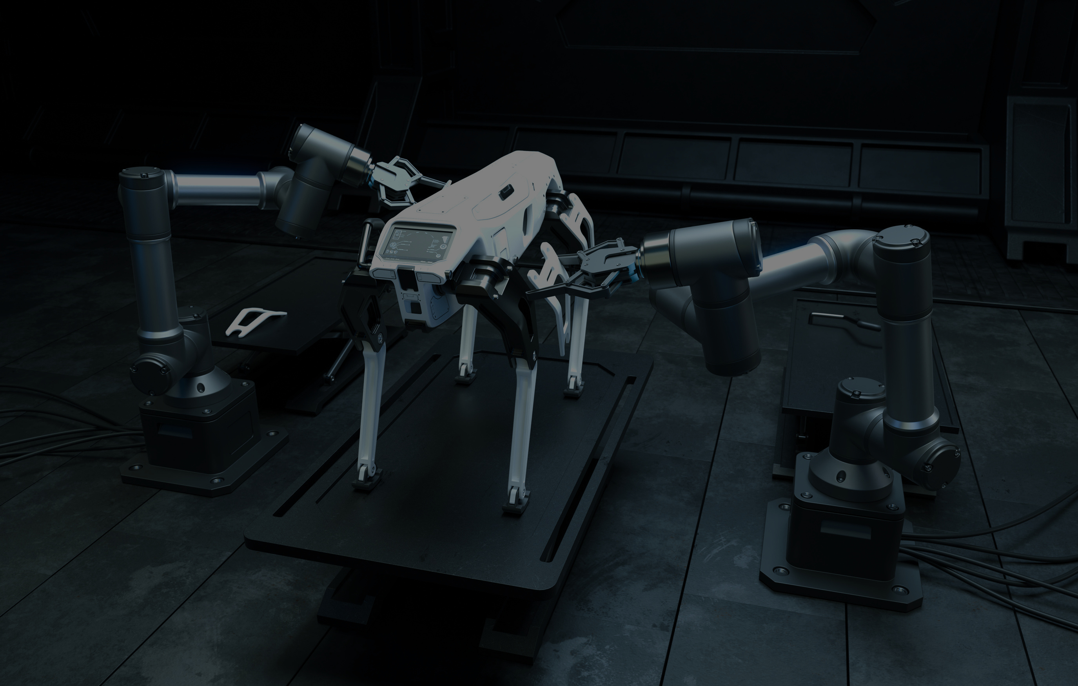

CSCI - 6660 TERM PROJECT
TEAM MEMBERS
NAVEENA DHULIPALLA
CHARITHA CHINNAPAPANNAGARI
JAHEERABI MOHAMMAD

Slide 2


PROJECT TOPIC
Comparative Analysis of Object Detection:
Deep Learning vs. Deep Reinforcement Learning Approaches
Our research investigates the hypothesis that the performance of object detection metrics, particularly accuracy, varies between Deep Learning (DL) and Deep Reinforcement Learning (DRL) approaches across different visual contexts

Slide 3


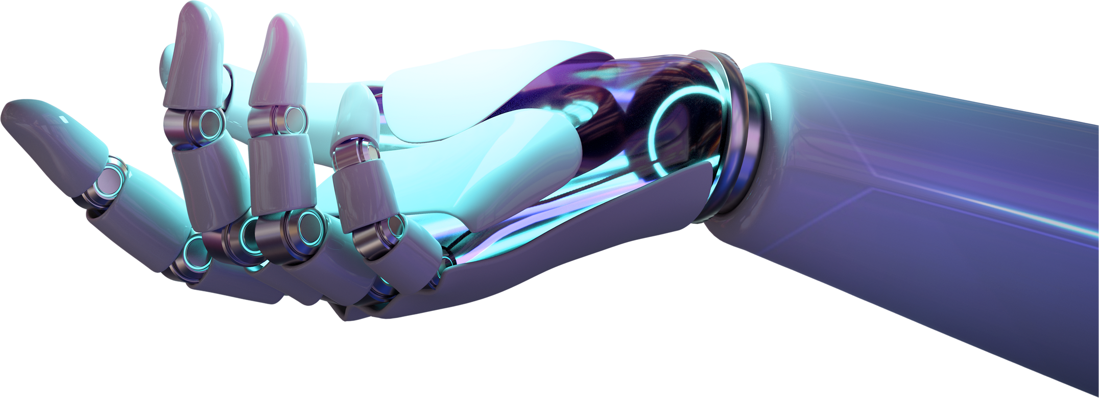
PROJECT OBJECTIVES
The goal of this project is to analyze and compare the effectiveness, accuracy, and real-time performance of object detection techniques like Region-based Convolutional Neural Networks (R-CNN), Single Shot Detector(SSD) in DL and Deep Q-Networks (DQN), Proximal Policy Optimization (PPO) in DRL frameworks. The project will focus on understanding how traditional deep learning methods differ from deep reinforcement learning-based methods in object detection tasks, particularly in different kind of environments.

Slide 4


APPROACH
Technology Stack
Python 3, TensorFlow, Keras
Tools
Jupyter Notebook, Kaggle
Intended Strategy
1. One method is taking a data set with multiple objects and performing detection using different DL and DRL algorithms and comparing both in static and dynamic environments.
2. Another way is to focus on one object in different complexity levels and environments and then making a comparative analysis by performing both Deep and Reinforcement Deep Learning algorithms on them.
3. And another way is to effectively combining both the above methods.

Slide 5

EVALUATION METHODOLOGY
PERFORMANCE APPROACHES
Using different complexity levels to show how each agent performs comparatively
AGILE APPROACH
DECISION MAKING
Reviewing how
well each AI agent
is performing in different conditions
Deciding which strategy is best by using different evaluation metrics like accuracy, precision, FPs, FNs etc.,
COMPARATIVE ANALYSIS
Creating tables to compare different methods in different environments and complexities

Slide 6
Final Strategy
Developed initial pipelines for both DL (R-CNN, SSD) and Deep Reinforcement Learning (DQN) approaches using python 3 in Jupyter notebook.
Integrated COCO dataset annotations for supervised learning and reinforcement signal generation.
This has been done on both static and dynamic environments for R-CNN and SSD like testing using COCO dataset in static and using key frames using web camera in dynamic environments respectively.
Ensured proper functionality of code for the mentioned cases. Implemented a reward mechanism for DQN to refine object localization iteratively.
.

Slide 7
Deep Learning Models (Faster RCNN)
Feature Extraction: Region based Convolution Neural Networks (R-CNN) uses pre-trained CNNs (e.g., VGG16, ResNet) to create feature maps from input images.
Region Proposal Network (RPN): Generates potential object regions (bounding boxes).
Pooling: Extracts fixed-size features from proposed regions for further processing.
Classification and Bounding Box Refinement: Classifies objects and refines bounding boxes.
Advantages: High accuracy, robust with small objects
.

Slide 8
Deep Learning Models (SSD)
.
Multi-Scale Feature Maps: Single Shot Mobile Detector (SSD) Uses feature
maps from different CNN layers for detecting objects at various scale.
Convolutional Filters: Predicts object class scores and bounding box offsets.
Non-Maximum Suppression (NMS): Removes duplicate boxes, keeping those
with higher confidence scores.
Advantages: Real-time detection, simpler architecture, easy to implement.

Slide 9
Reinforcement Deep Learning Model Deep Q-Network (DQN)
.
DQN (Deep Q-Network):
It combines Q-learning with deep learning techniques, which helps
agents to learn how to make decisions in environments with high
dimensional input spaces (e.g., images or videos).
The agent starts with a feature extraction step, typically using a
Convolutional Neural Network (CNN) to convert raw images into feature
maps (or image embeddings) that represent the content of the image.

Slide 10
Reinforcement Deep Learning Model
Proximal Policy Optimization (PPO)
.
Proximal Policy Optimization
PPO is an on-policy reinforcement learning algorithm that is considered
more stable and reliable than traditional policy gradient methods.
PPO uses a clipped objective function to ensure that the policy updates
are not too large, which helps improve stability and prevents the agent
from making extreme updates based on a single experience.

Slide 11
Reinforcement Deep Learning Model
Proximal Policy Optimization (PPO)
.
Clipped Surrogate Objective:
One of the hallmarks of PPO is its clipped surrogate objective, which is
designed to limit the ratio between the probabilities of actions taken by
the old and new policies. This clipping effectively prevents excessive
updates that could destabilize training.

Slide 12


DELIVERABLES
Documention Model
Hands-on Programming
Detailed instructions (Documentation model) on how each algorithm works in different conditions using DL and Reinforcement Deep Learning.
Ready-to-use computer programs (Algorithms)
written in Python for both Deep Learning and Reinforcement Deep Learning Algorithms.
Presentation
Github
A video on YouTube showing how our project works, along with a presentation slide.
https://github.com/CharithaC951/CSCI-6660-TermProject.git

Slide 13
CONCLUSION
As it is a comparative analysis, according to our study
During Static environment and in case of single object in an image, SSD
and FasterRCNN are working very similar and giving good performance.
While working with multiple objects in an image where the objects are
tiny or overlapping, SSD is giving better results in comparison with FasterRCNN.
As of Dynamic environment, SSD and FasterRCNN are giving similar and
promising results but not as good as their performance in static environment.
This is due to camera quality, frame rate, lighting and frequently changing
external noises in the frames.
.

Slide 14
CONCLUSION
DQN offers a novel approach for object detection by framing it as a reinforcement learning problem.
The COCO dataset provides a comprehensive benchmark to train and evaluate DQN-based object detection models.
The combination of CNNs and DQNs can result in improved object localization and classification accuracy.
PPO is an emerging approach for training object detection systems in a reinforcement learning context. By treating object detection as an RL problem, PPO allows for more dynamic and adaptable models.
Further research into improving reward function design, stability, and generalization in diverse environments.
.

Slide 15
.
THANK YOU

